Slide 1

HTML/CSS Intro

Slide 2

Setting Up Your Integrated Development Environment (IDE)
Go to: https://code.visualstudio.com/ or search for “VS Code”
Set up the live server extension in VS code
Create a new empty folder on your desktop title “portfolio”
Open the folder on VScode, create two pages:
index.html
style.css

Slide 3
HTML

Slide 4
HTML basics
HTML is used to specify the structure.
It attaches hierarchy, relationships, and meaning to your content, but not anything visual! (This is what CSS does)
It adds structure with elements, which are tags!
Full list of tags here: https://www.w3schools.com/tags/default.asp

Slide 5
Main Tags We’ll Use Today
<div> | Defines a section in a document
<h1> to <h6> | Defines HTML headings
<img> | Defines an image
<p> | Defines a paragraph
<ul>, <ol>, <li> | <ul> defines an unordered list, within that list are usually bullets <ol> defines an ordered list, which usually uses numbers. Both lists use <li> to specify list items
<em> | Defines emphasized text
<a> | Defines a link
<link> | Defines the relationship between the current document and an external resource.

Slide 6
Adding Structure to Text
“NBNteractives is a section of around 10 students that are interested in journalism and technology. We enjoy creating North by Northwestern articles that are interactive, by adding elements such as quizzes, animation, data visualizations, and more. We meet every Sunday at 3:00pm CST. Check out some of our projects”
Not very easy to read… how can we add structure?

Slide 7
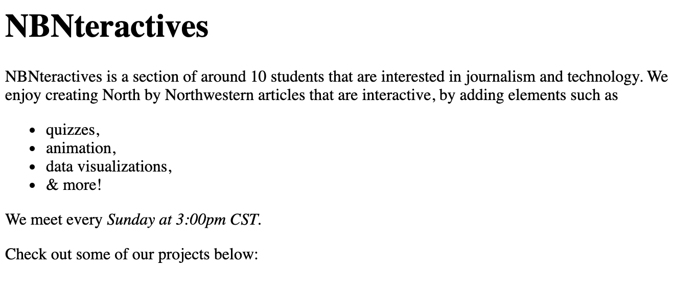
With HTML!
(not very visually pleasing… but we’ll get into that later! 😊)

Slide 8
Assigning Attributes to HTML elements
All HTML elements can have attributes, which provide additional info
Attributes are assigned in the opening tag
<a href=“google.com”> Google </a>
Classes & IDs are attributes that are used to identify specific pieces of content in CSS and JS
Can be applied to all attributes
More on attributes: https://www.w3schools.com/html/html_attributes.asp
Full list: https://www.w3schools.com/tags/ref_attributes.asp

Slide 9
CSS

Slide 10
Cascading Style Sheets (CSS)
A way to style your HTML elements!
CSS styles have selectors and properties
selector { property: value; property: value; }
There are different types of selectors, and different properties
Always link your stylesheet in the <head> element
<head>
<link rel="stylesheet" href="style.css">
</head>

Slide 11
CSS Selectors
To choose the HTML you want to style, you must select it
There are different ways to do this:
Type Selectors
Ex: h1, body, p, div
Match the HTML elements of the same name
Descendant selectors
Ex: div p
Selects p elements in a div
Class selectors
Ex: .content
Selects elements that are assigned to “class = content”
ID Selectors
Ex: #content
Selects elements that are assigned to “id = content”
Full list of CSS selectors: https://www.w3schools.com/cssref/css_selectors.asp

Slide 12
CSS Properties
Once you’ve selected your elements, you use CSS properties and values to form their styles!
Colors, sizes, margins, padding, fonts, etc are all examples of properties
Full list of CSS properties: https://www.w3schools.com/cssref/

Slide 13
Adding Colors
Color Palette generator: https://coolors.co/
Colors can be specified many ways:
Named colors: red, orange
Hex values: #ffffff
RGB values: rgb(10, 10, 10)
RGB values with transparency: rgba(10, 10, 10, 0.5)
To change the font color, use the following property/value:
color: [insert color here]
To change the background color, use the following property/value:
background-color: [insert color here]

Slide 14
Adding Fonts
Fonts: https://fonts.google.com/
Try to keep it to less than 3 fonts
Importing Google Fonts
Property/value pairs:
font-family: “Open Sans”, sans-serif
font-weight: bold;

Slide 15
Changing the Size of Elements
CSS has several units that express length
Ex: px, in, cm, etc
Many properties take “length” values
The width, margin, padding, font-size properties all take in length values
There are absolute lengths, which are fixed:
Ex: cm, px, mm, in
There are relative lengths, which scale better between different devices/screen sizes
Ex: em, vw
Using relative widths is recommended since screen sizes vary
More on lengths: https://www.w3schools.com/cssref/css_units.asp

Slide 16
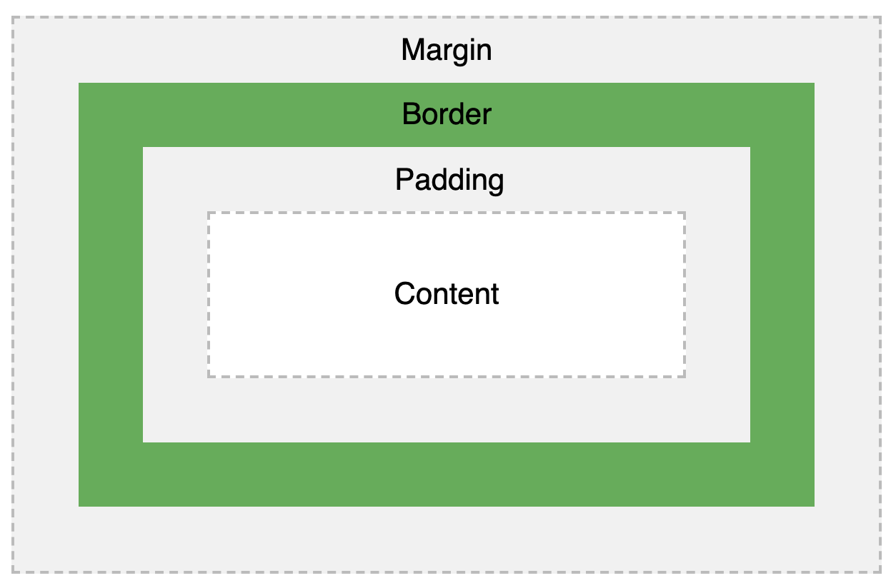
Margins & Padding
The margin & padding allow you to define space between elements
Both are transparent
The margin clears the area outside the border
The padding clears the area inside the border
More on margins: https://www.w3schools.com/css/css_margin.asp
More on padding: https://www.w3schools.com/css/css_padding.asp

Slide 17
Animating on Hover
Use the selector “:hover”
Ex: “.content.hover” will select the element with” class = content” when your mouse hovers over it
Change the property values within that selector
Ex: p:hover {background-color: red}
Turns the paragraph’s background-color red on hover
Add a transition to change the property value smoothly
Ex: p {transition: 0.3s}
Will transition over a 0.3s duration
More on transitions: https://www.w3schools.com/css/css3_transitions.asp

Slide 18
Additional Tools

Slide 19
Other Things You Could Add
Accordion: https://www.w3schools.com/howto/howto_js_accordion.asp
Navbar: https://www.w3schools.com/css/css_navbar.asp
Animation Libraries
https://greensock.com/gsap/ (gsap.js)
Set up a free github page
https://guides.github.com/features/pages/

